Slide 1
Web Scraper
Submitted By:
Kanwardeep Singh
2210990473
Submitted To:
Tkhitoliya Sir
Chitkara University Institute of Engineering and Technology (CUIET)
Chitkara University, Punjab

Slide 2
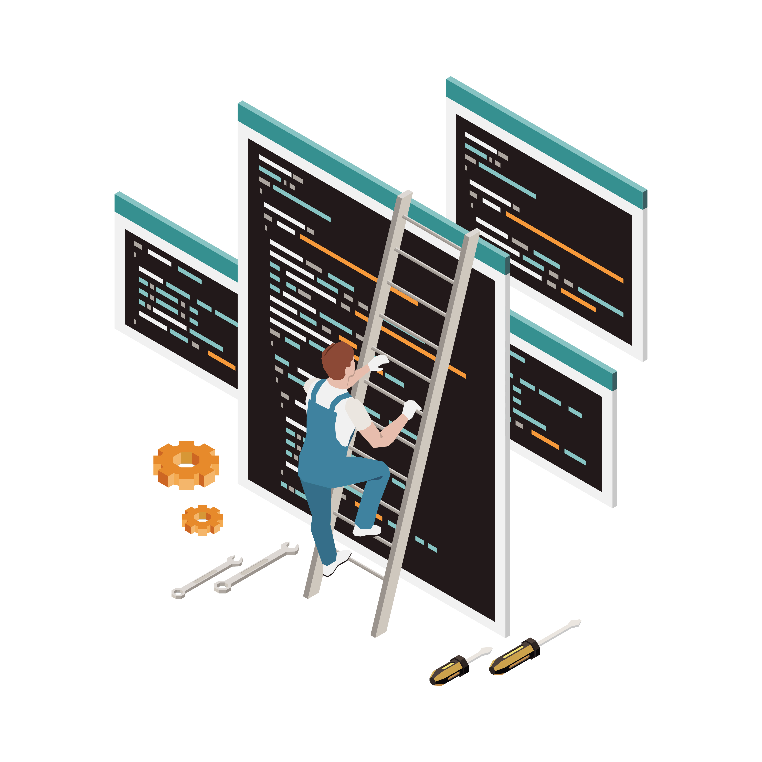
Outline
Introduction
Problem Statement
Motivation
Justification for Project
Objective
Methodology
GUI
Code snippets
References

Slide 3
Introduction
Objective: The "Web Scraper" project aims to automate the extraction of text content from web pages, simplifying data retrieval for users.
Technology Stack: It leverages Python for backend logic, Flask for web routing and handling, HTML for structured frontend design, and Tailwind CSS for responsive and modern styling.
Input Parameters: Users provide the URL of the target website and specify a tag name to indicate the content they want to extract.
Data Display: Upon processing, the Web Scraper displays all text content within the specified tag on the website, offering a streamlined view of relevant information.
User Experience: With its intuitive interface and efficient scraping functionality, the project enhances user productivity by providing quick access to desired web data.

Slide 4
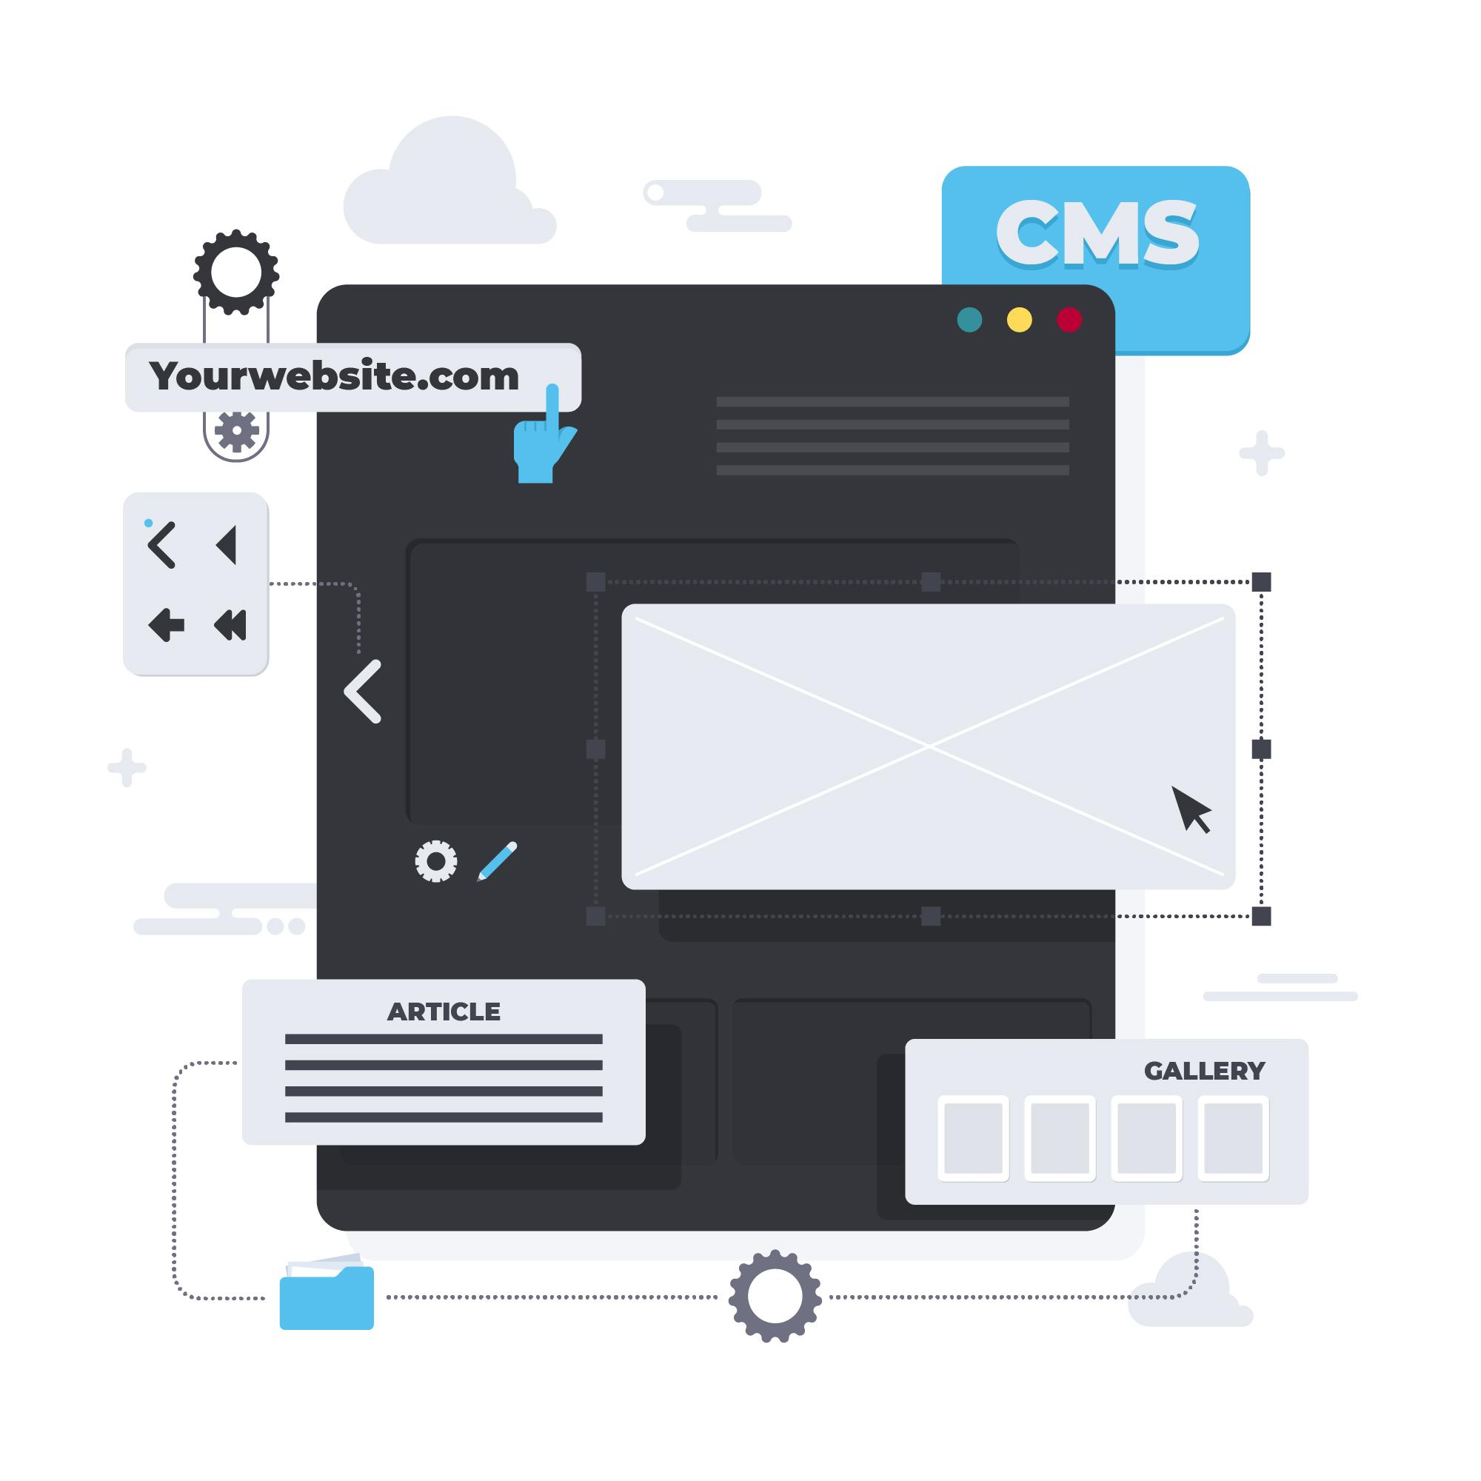
Problem Statement
Develop a web application that allows users to input a website URL and a tag name. The application should extract and display all text content within the specified tag on the website. This project aims to automate data extraction from web pages for user convenience.

Slide 5
Motivation
Save time by automating the process of extracting text content from websites.
Improve data accessibility by providing a tool for targeted information extraction.
Enhance productivity by streamlining data retrieval tasks and enabling efficient utilization of web data.

Slide 6
Justification for Project
Provide efficient automation for extracting text content from websites, saving time and effort.
Facilitate targeted information retrieval, enhancing data accessibility for users.
Streamline data extraction tasks, leading to improved productivity and utilization of web data for various purposes.
Enable users to gather specific data from multiple websites quickly and accurately, contributing to informed decision-making and analysis.

Slide 7
Objective
Develop a user-friendly web application.
Allow users to input a website URL and a tag name.
Extract all text content within the specified tag on the website.
Streamline the process of data extraction from web pages.
Provide users with a convenient tool for accessing relevant information quickly and efficiently.

Slide 8
Methodology
Analyze project requirements and select appropriate technologies.
Develop backend functionalities using Python and Flask for user input handling and data extraction.
Design and implement frontend using HTML and Tailwind CSS for user interface and styling.
Test the application for functionality and usability.
Deploy the completed application for user access.

Slide 9
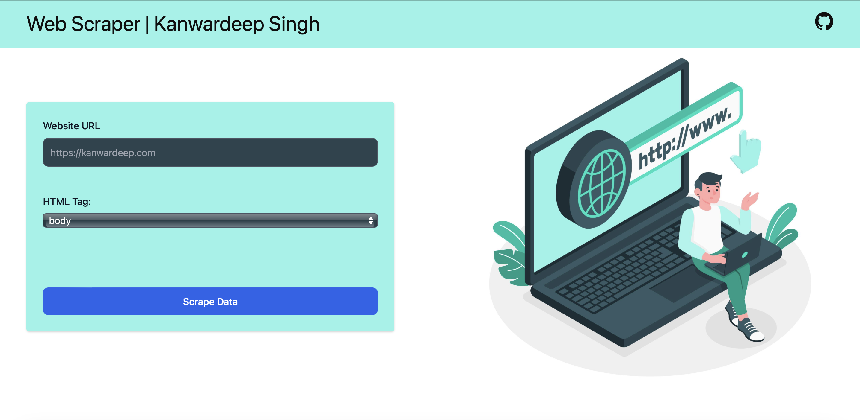
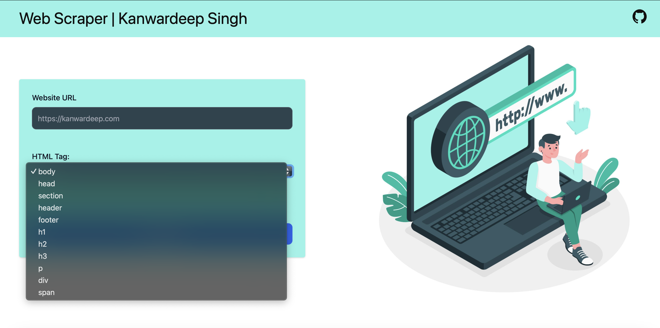
Input Page

Slide 10
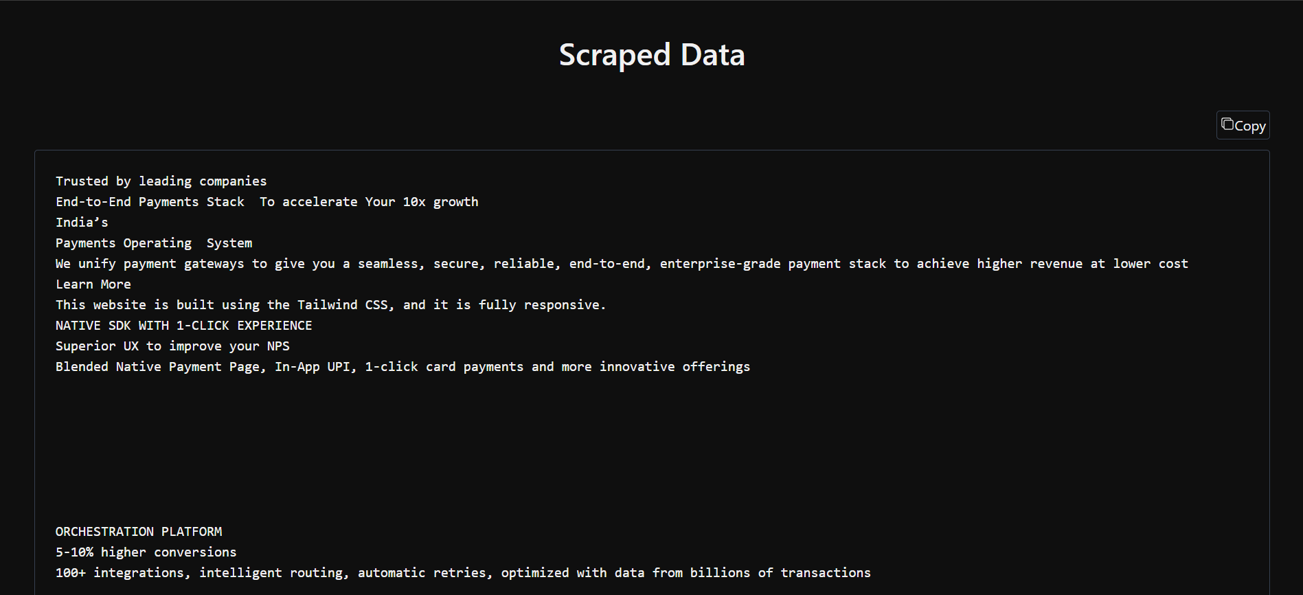
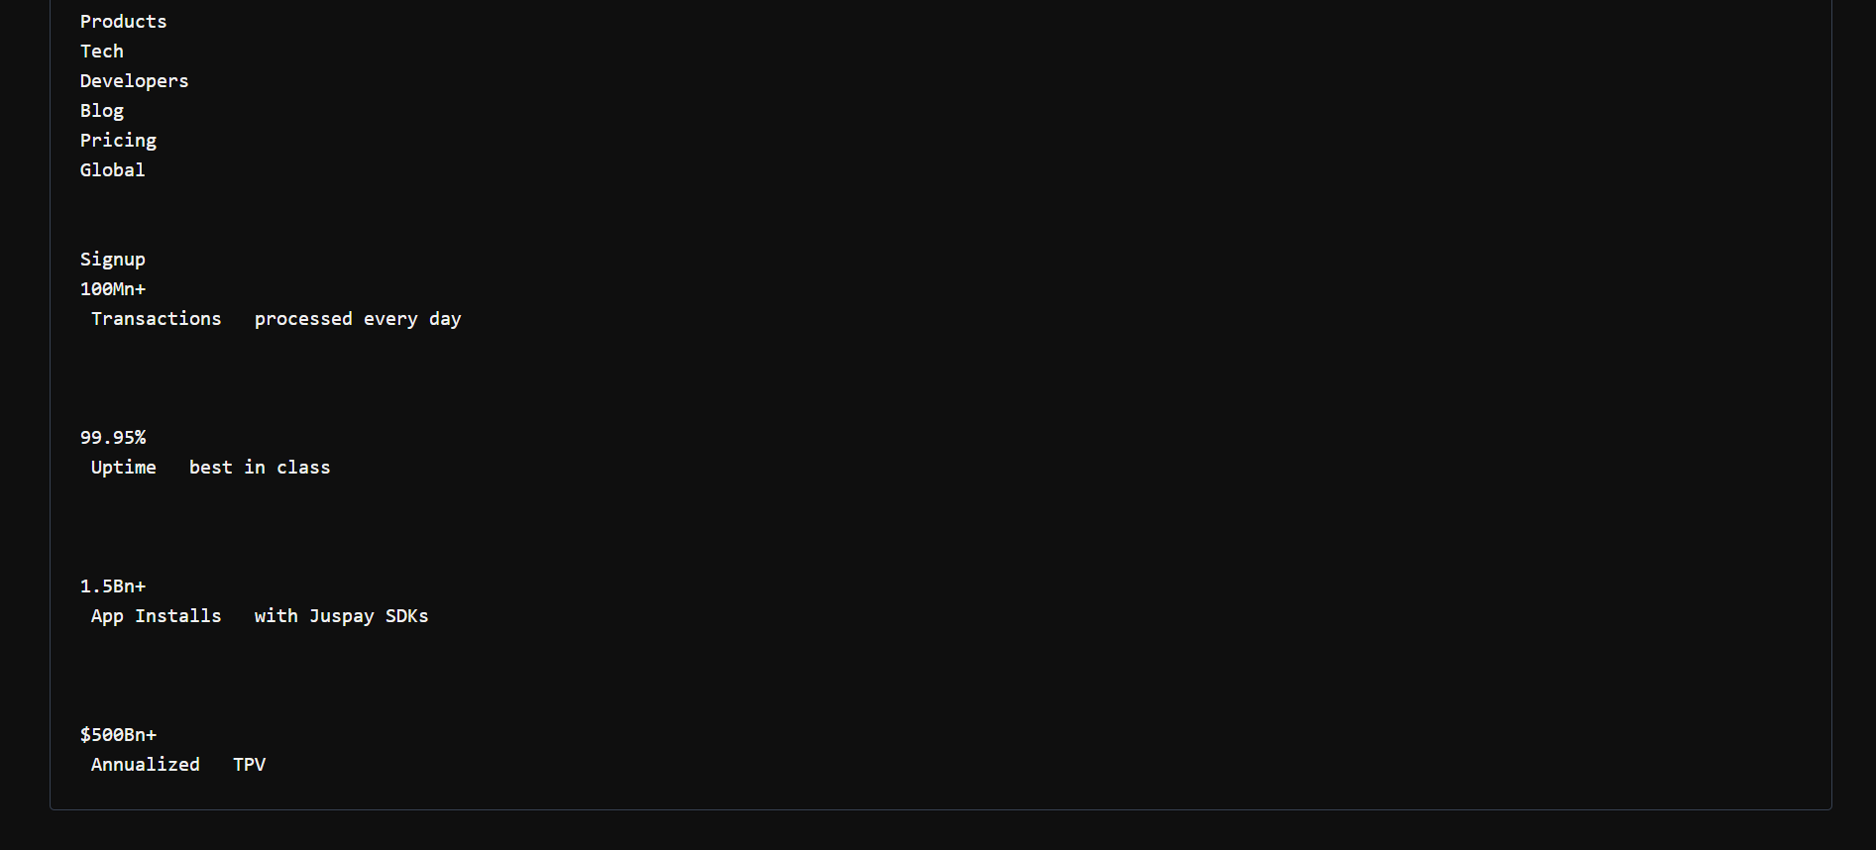
Display Page

Slide 11
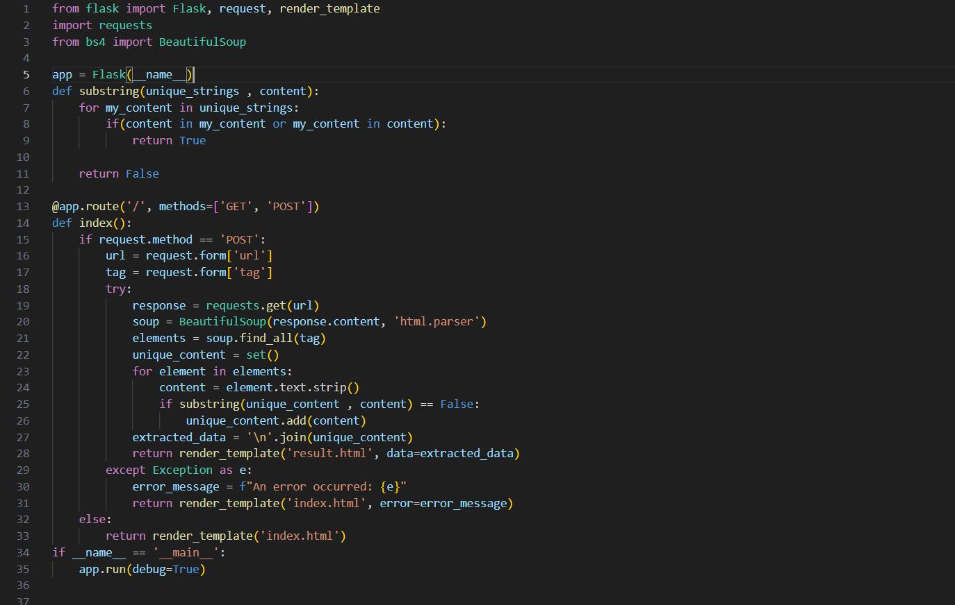
Code Snippets
app.py

Slide 12
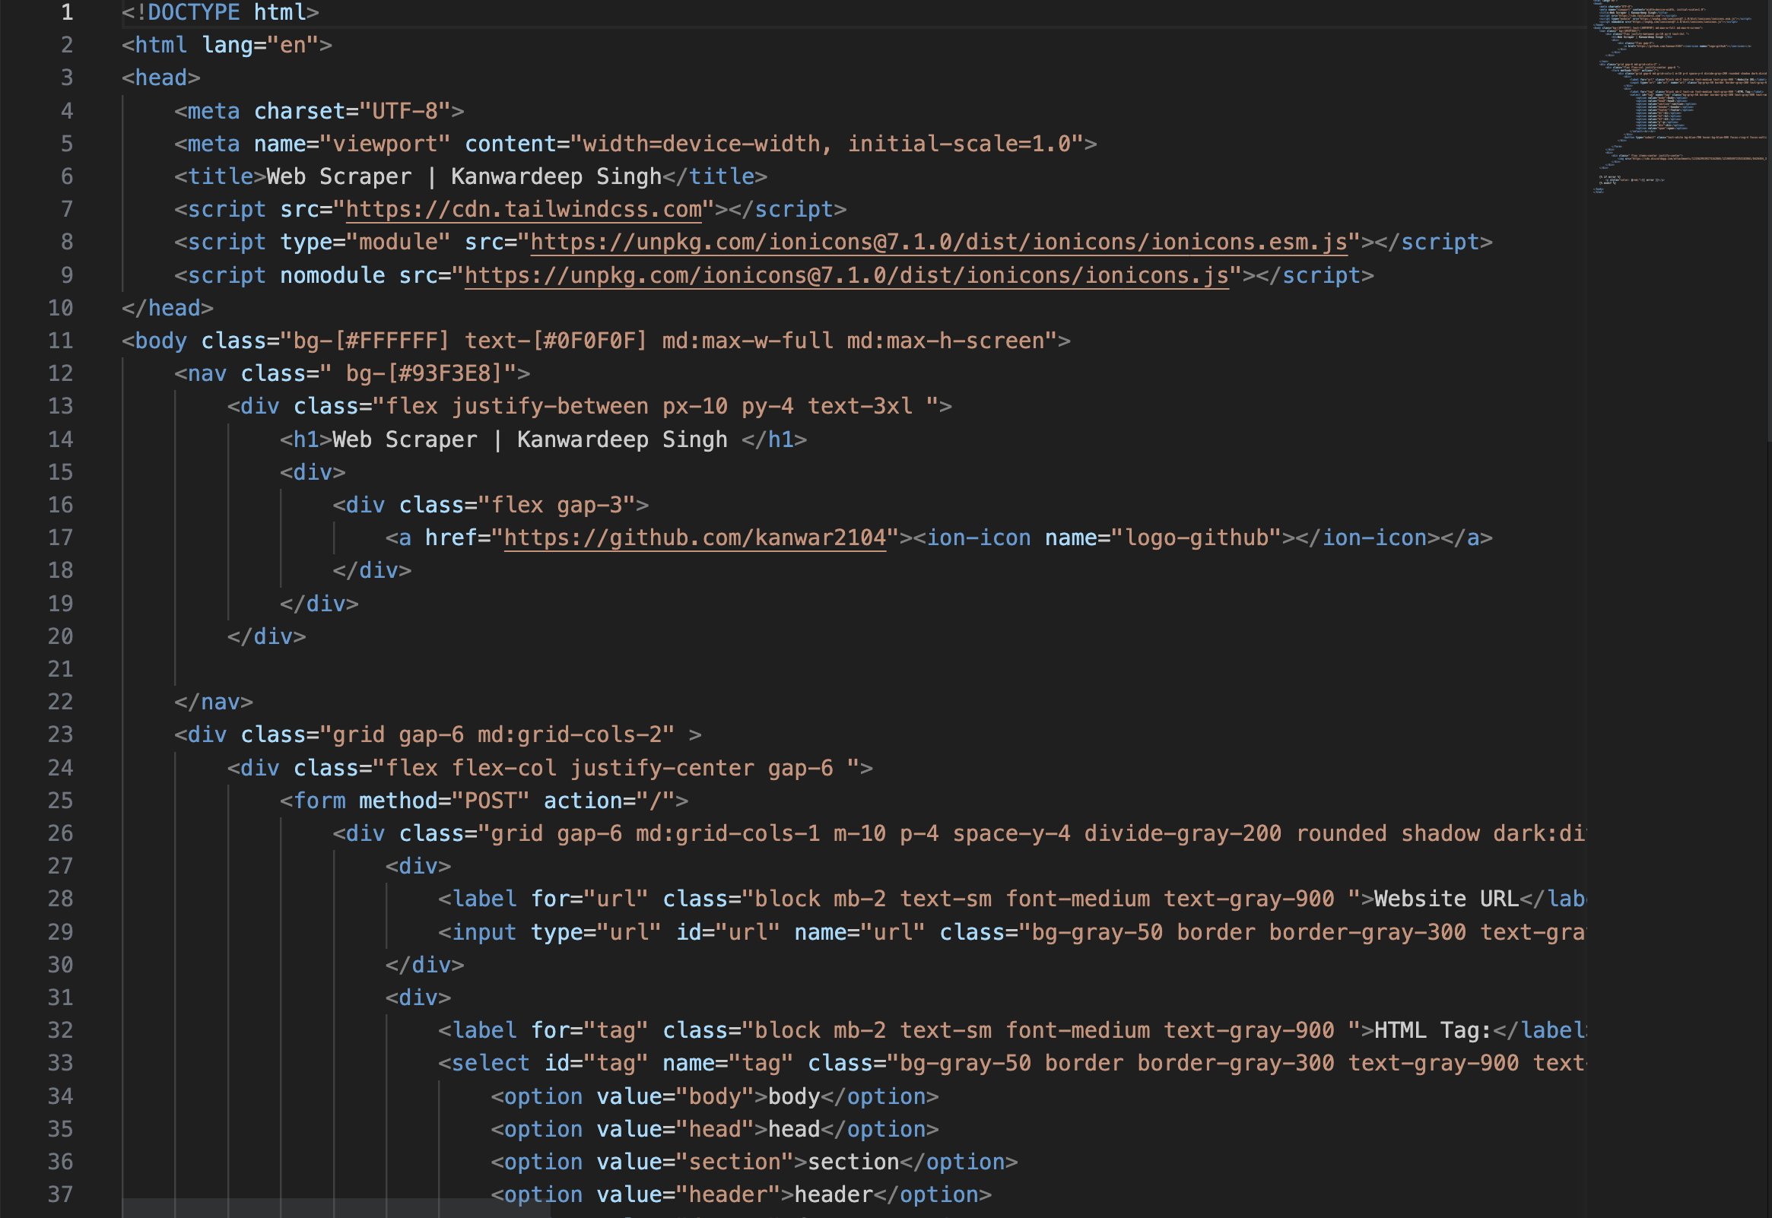
Code snippet
index.html

Slide 13
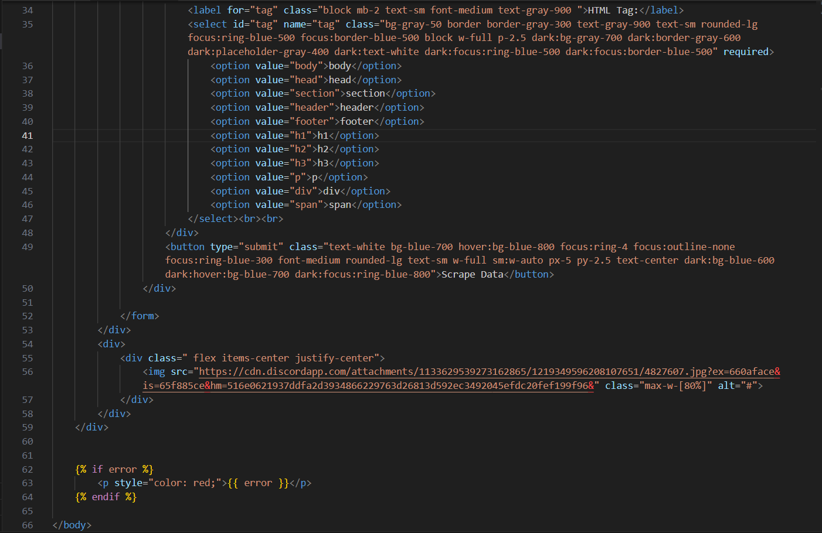
Code snippet
index.html

Slide 14
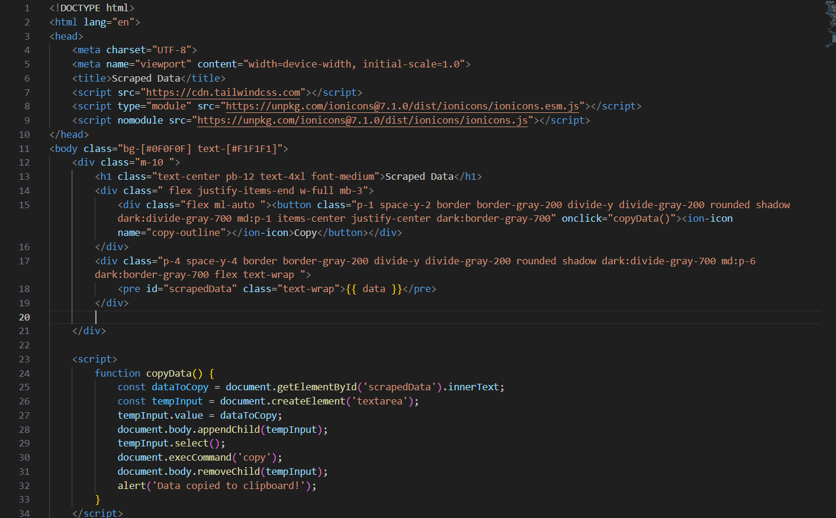
Code snippet
result.html

Slide 15
References
GeeksForGeeks
https://www.geeksforgeeks.org/
Tailwind Documentation
https://tailwindcss.com/docs/installation
Python Documentation
https://docs.python.org/3/
Wikipedia
https://en.wikipedia.org/wiki/Morse_code

Slide 16
Thank You

